Slide 1
GDP per Capita vs Life Expectancy
By Erich Skrotzki

Slide 2
Choosing a Database
Finding a proper database was my first main goal for this project. After going through multiple different sites I decided to us the World Bank dataset.
I chose The World Bank because it was simple to use, easy to download, and had a multitude of datasets to use. These datasets ranged in categories from Agriculture Development and Aid to Infrastructure and Trade.
Using data from the World Bank database I decided to see if there was a correlation between GDP per Capita and Life Expectancy for the world.

Slide 3
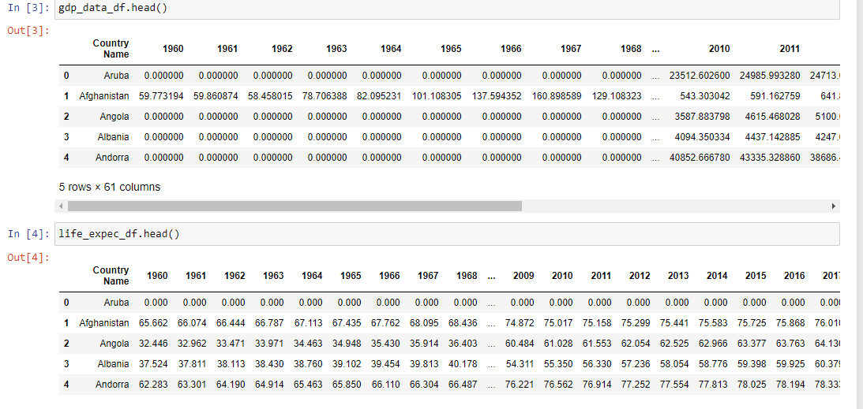
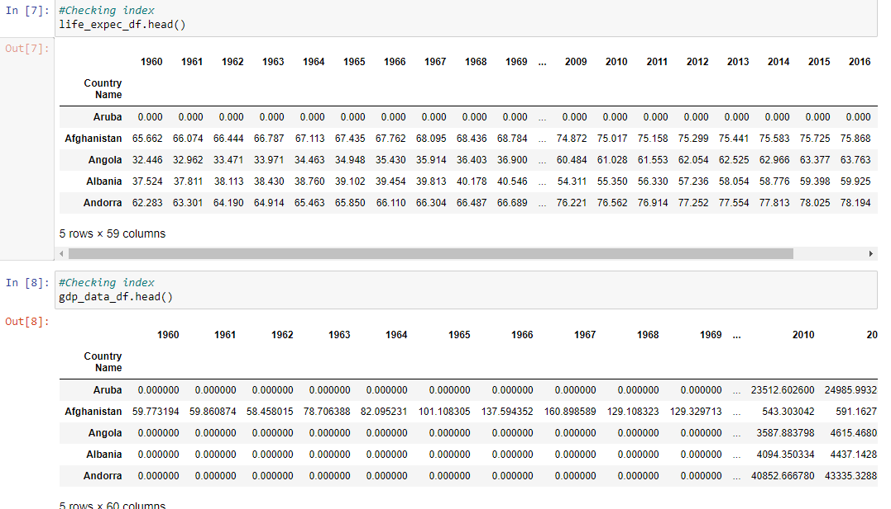
Trimming the Data
The World Bank had data from 1960 to 2019 for every country.
After gathering the data, first order of business was to clean the empty cells up using fillna to fill each NaN value with a 0.
After, I set the index as the country name so that the dataset looked better and was easier to read.

Slide 4
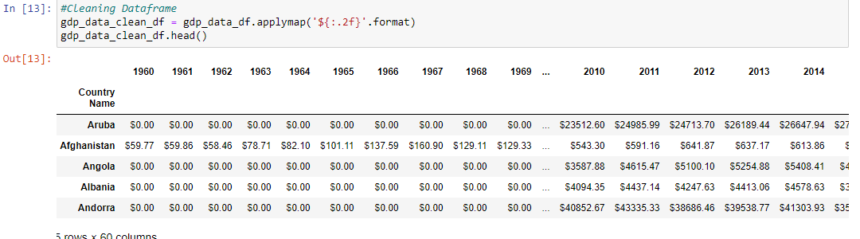
More Trimming
Since the data I was going for was in Years and the US Dollar ($) I decided to round both datasets to 2 decimal places and use the .applymap function to apply the accounting number format to my GDP data. This gave me the dataframe shown to the right.

Slide 5
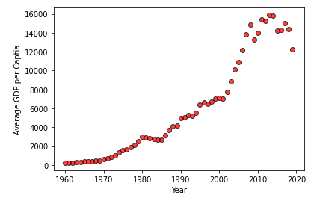
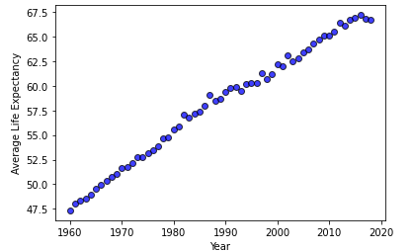
Plotting the Data
The main point of the project was to see if there was a correlation between the Average Life Expectancy of the world and GDP per Capita of the world.
Below are the scatter plots for average GDP per Capita and Average Life Expectancy. Looking at the data, there seems to be a correlation between Average GDP per Capita and Life Expectancy.

Slide 6
Finding a Correlation
When digesting data and information, you have to also look at what brings these changes to light.
When you think about the basic jist of my project, as GDP of a country goes up, so do Government Services. Examples of these are education, roads, government subsidies and grants, and most importantly healthcare.
As the access and the improvements to healthcare in infrastructure increase people are more likely to live longer, as well the average age of the population increases.

Slide 7
Average GDP per Capita vs Life Expectancy
In the graphs below, as we see an increase in GDP, we also see an increase in life expectancy. This means that there is a correlation between both datasets!

Slide 8
Possibilities of Data
In my dataset alone, there are many possibilities of how to interpret the data. I could determine growth between certain countries, regions or continents vs other continents.
The possibilities are endless.

